Slide 1
Using Axios with Routing
Vishala Singa

Slide 2
What is Axios?
Axios is a promise-based HTTP Client for node.js and the browser . It is isomorphic.
We use Axios for GET,POST,PUT,DELETE requests.

Slide 3
Features of Axios
Handles HTTP requests and responses.
Supports async/await syntax.
Configurable headers and timeouts.

Slide 4
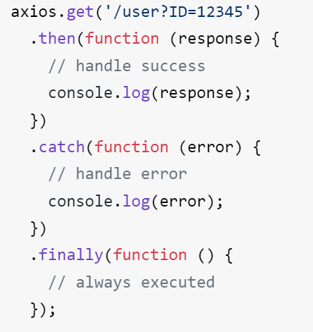
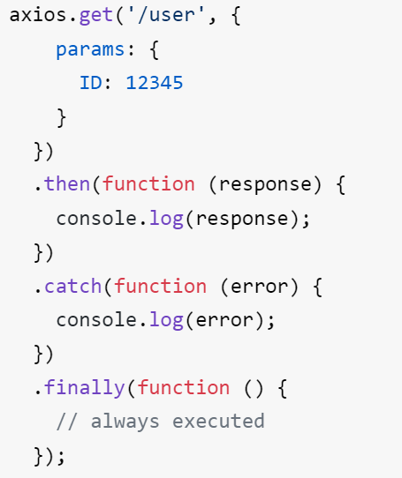

Slide 5
What is React Router?
A library for managing routing in React applications.

Slide 6
Components of React Router
BrowserRouter - Handles navigation.
Route - Defines routes.
Switch - Renders the first matching route.
Link - Navigates between routes.

Slide 7
How to use Axios and Routing in Application

Slide 8
THANK YOU

